Slide 1
Graphs and Social Networks
Dr. Luis Garcia
Information Sciences Institute
USC
lgarcia@isi.edu
Saptadeep Pal
Electrical and Computer Engineering Department, UCLA
saptadeep@g.ucla.edu

Slide 2

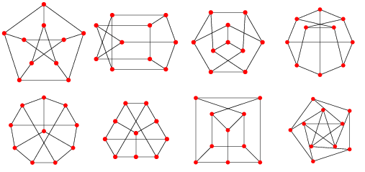
In This Lecture…
We are going to:
Introduce the concepts of a social network and graph theory
Play ‘Six Degrees of Kevin Bacon’
Learn some basic graph theory
Then we will do programming exercises:
Easier: some simple graph theory
Harder: path and cycle detection
find connected components
Notes:
This slice shows the content structure of this lecture.

Slide 3
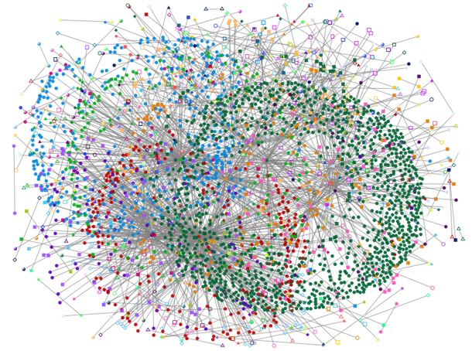

Social Networks
Q: What’s a social network?
A: It is a structure made up of individuals (or organizations, or agents, or anything else) tied together by relations or connections – such as friendship, alliance, financial or common interest, etc…
Q: Why should we study social networks?
It’s useful! Tons of applications:
Finding friends and matchmaking .
Locating appropriate customers for companies (marketing).
Preventing spreading of diseases in epidemics…

Slide 4
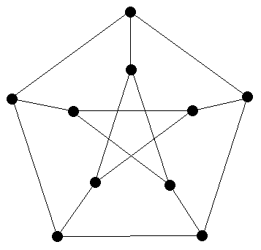
Graph Theory
The main tool used to understand social networks is graph theory.
An example of a graph:
Petersen graph
Notes:
Come up with three exercises:
Something to do with web server/client.
Something to do with HTTP.
Something combine internet, web server/client, HTTP together.
We don’t have to use the chat client code if it is not too related to the ideas in the slice. But I think we can at least use it for the third exercise, if the chat client uses HTTP protocol.

Slide 5
Graph Theory
The main tool used to understand social networks is graph theory.
An example of a graph:
Petersen graph
Notes:
Come up with three exercises:
Something to do with web server/client.
Something to do with HTTP.
Something combine internet, web server/client, HTTP together.
We don’t have to use the chat client code if it is not too related to the ideas in the slice. But I think we can at least use it for the third exercise, if the chat client uses HTTP protocol.

Slide 6
Graph Theory
A graph is made up of nodes (also called vertices) and edges:
Which are the nodes and which are the edges in the graph below?
Petersen graph

Slide 7
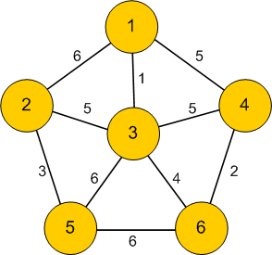
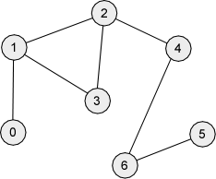
Graph Theory
• Edges can be weighted or unweighted
Weights: allow us to express the importance of a connection.

Slide 8
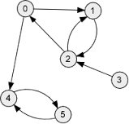
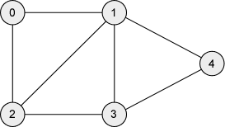
Graph Theory
• Edges can be directed or undirected:
Directions allow us to have influence go one way (rather than mutual).

Slide 9
Example of directed edges in a graph
Rock – Paper – Scissor Game
rock
rock
covers
crushes
paper
scissor
paper
scissor
cuts

Slide 10
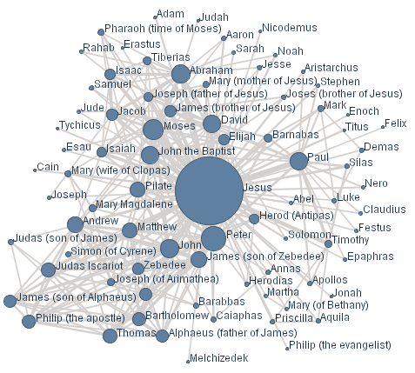
Graph Theory
Q: Why do we care about graphs?
A: We can use them to represent a social network:

Slide 11
Acting Networks
A good example of a network is formed by our coworkers, their coworkers, etc…
We’ll look at Hollywood actors.
We’ll say that two actors are connected if they played in the same film.

Slide 12
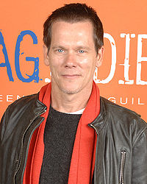
Kevin Bacon
Q: Who is the “center” of the movie universe?
A: Kevin Bacon. Have you heard of him? If not – it’s because he’s known for playing a supporting role in a huge number of films:
Kevin Bacon

Slide 13
Kevin Bacon
We can play a game called ‘Six Degrees of Kevin Bacon.’
The rules:
Pick an actor or an actress.
If they have played in a film with Kevin Bacon, their Bacon number is 1.
If they have played in a film with someone with a Bacon number of 1, they have a Bacon number of 2.
Etc…
Example: Bradley Cooper:
Bradley Cooper was in “Silver Linings Playbook” (2012) with Jennifer Lawrence.
Jennifer Lawrence was in “X-Men: First Class” (2011) with Kevin Bacon.
So Bradley Cooper has a Bacon number of 2.

Slide 14
“Six Degrees” Game
Exercise:
Using IMDB, find the Bacon number (and path) for:
Julia Roberts
Selena Gomez
Christian Bale

Slide 15
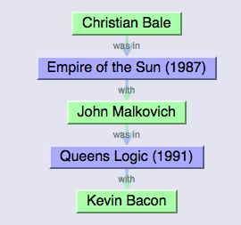
“Six Degrees” Game
It’s a lot easier with an automated tool that searches IMDB:
http://oracleofbacon.org/cgi-bin/movielinks
For example, it produces this output for Christian Bale:

Slide 16
“Six Degrees” Game
Exercise: Try out the Oracle tool with your favorite actors.
What’s the largest Bacon number you can get?

Slide 17
“Six Degrees” Game
We saw a lot of actors with Bacon numbers 1 and 2.
What about the extremes?
What’s the smallest possible Bacon number? Who has it?
What’s the largest possible Bacon number?
What if someone is not connected to Kevin Bacon at all?
Among those who are, what’s the largest Bacon number?

Slide 18
“Six Degrees” Theorem
The “Six Degrees” idea states that any two people selected at random are connected by at most 6 degrees.
Of course, there are some counterexamples, but they’re rare.
Same applies to Hollywood – which is why the game is called “Six Degrees of Kevin Bacon.”

Slide 19
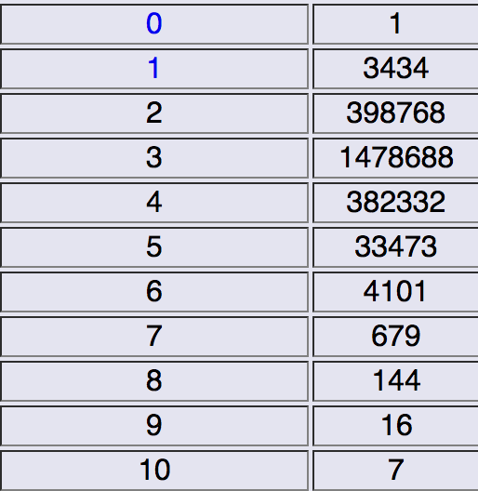
Back to Kevin Bacon
Here’s a statistic about Kevin Bacon numbers for other actors:
Bacon Number # of People

Slide 20
Back to Kevin Bacon
What can we see from the table?
Most people have a Bacon number of 3.
Slightly less have a Bacon number of 2 and 4.
Bacon numbers higher than 4 are rare.
The maximum is 10.

Slide 21
Back to Kevin Bacon
You can replace Bacon with other actors to see who makes a good “center” for connections.
Try it out:
http://oracleofbacon.org/cgi-bin/center-cgi

Slide 22
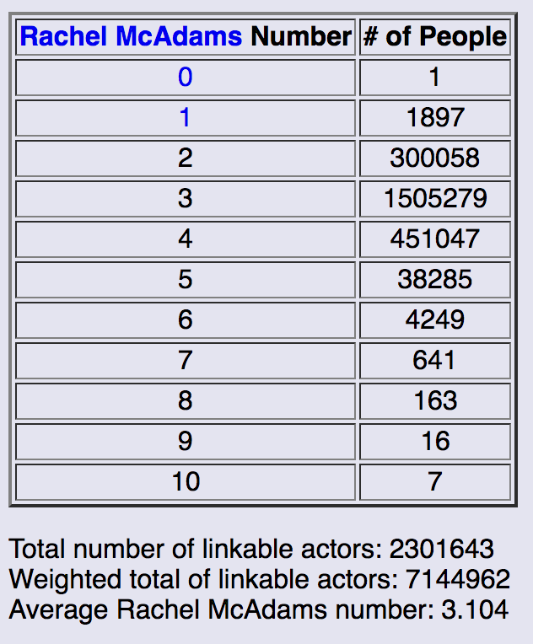
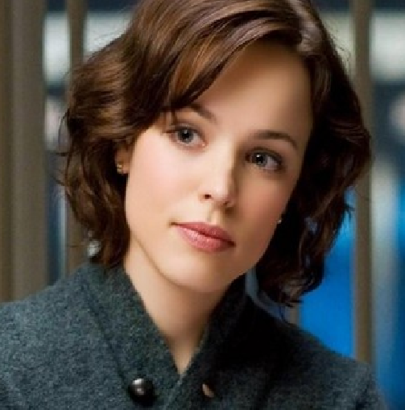
Back to Kevin Bacon
What does it mean to be a good “center?”
For example, we see that Tom Cruise has an average number of 2.976 while Bacon has an average of 3.026. Who’s better?
Exercise: Try out your favorite actor. Who picked the best center?

Slide 23
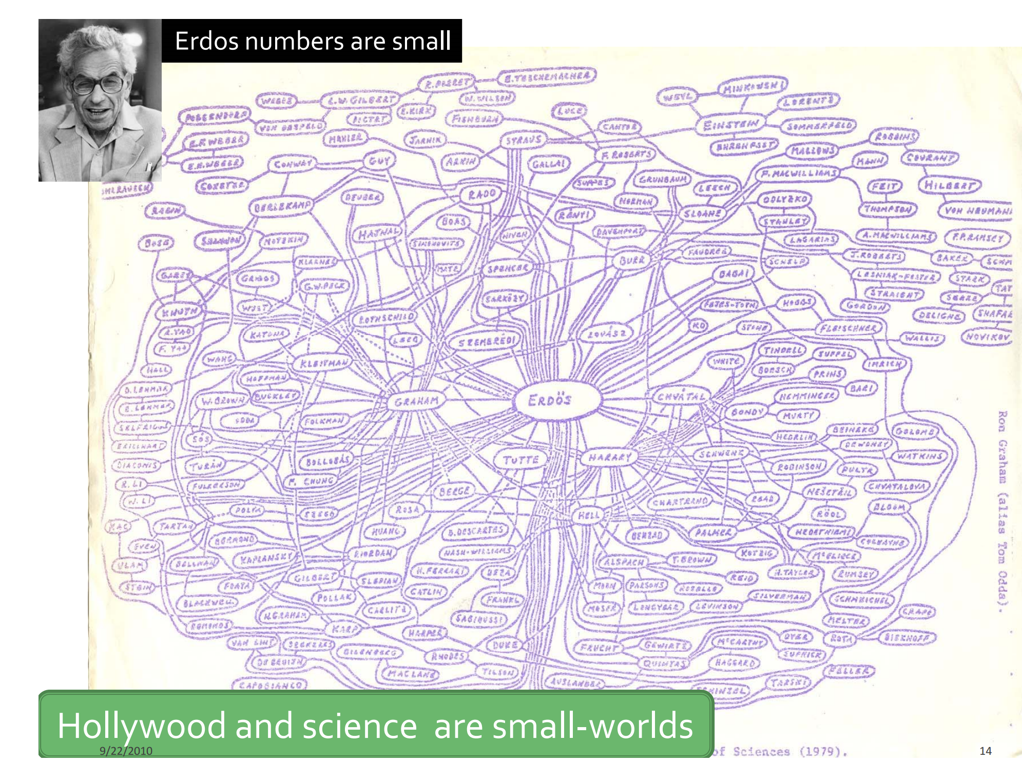
What about the world of science?
Erdős numbers:

Slide 24
What’s your Erdos number?
Siyi Yang (creator of this module): 3
Paul Erdős
Peter J. Cameron
A. Robert Calderbank
Siyi Yang
Compute: https://oakland.edu/enp/compute/

Slide 25
Larger networks
We saw, from the Kevin Bacon game, that
1. Hollywood has about 1 million actors.
2. Most of them can be related to each other within 4 connections.
What about all the people in the US?
Population is about 300 million.
Q: About how many connections on average between two random people?
(Note: define connection here as “being acquainted with.”)

Slide 26
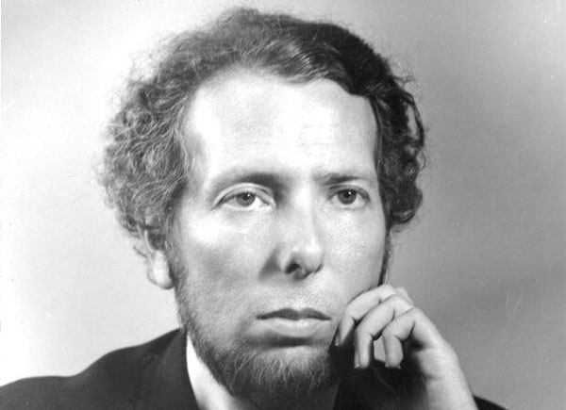
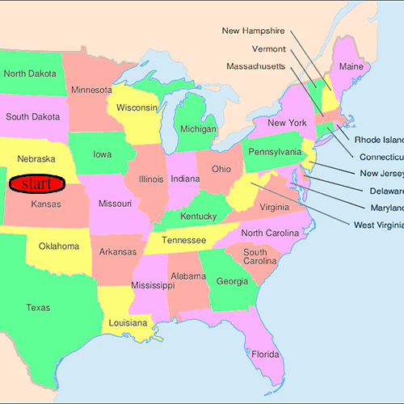
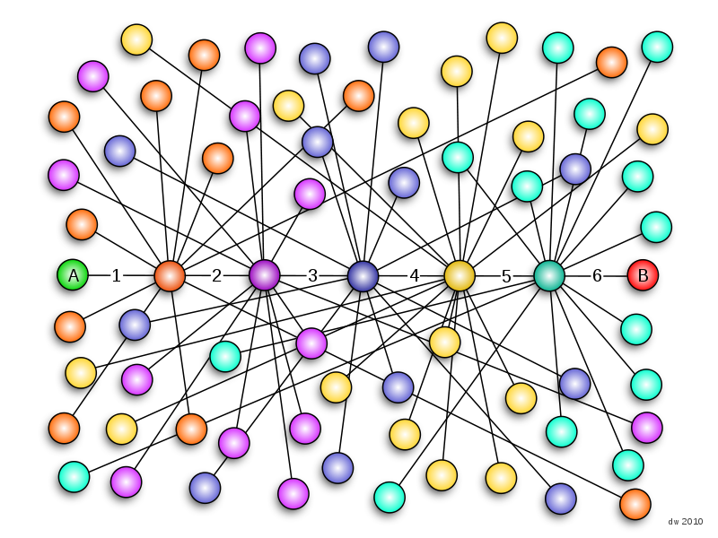
Larger Networks
“Six Degrees” Theorem still applies!
So, if we pick two random people in the US, using a chain of “friends of friends”, we should be able to connect them within 6 connections.
Studied by the famous psychologist Stanley Milgram in his “Small world experiment” in the 1960’s.
Easily recreated today using Facebook!
Stanley Milgram

Slide 27
“Six degrees” Theorem
So what’s useful about it? Applications?
One example: Insurance companies request customers to provide 5 referrals in order to expand their business.
Exercise: Come up with another example.

Slide 28
Graph Theory
We’ve talked about networks, connections, “distances”, etc…
Now it’s time to describe the math behind this.
This area is called “graph theory.”

Slide 29
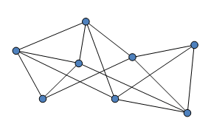
Graphs
A graph is made up of “nodes” and “edges.”
Nodes are denoted by a dot/vertex.
Edges connect two nodes.
If two nodes have an edge between them, they are “adjacent” or “neighbors.”

Slide 30
Degrees
The number of edges coming out of a node is called its “degree.”
What are the degrees of the nodes in the graph below?
All nodes have same degree: regular graph. If not, irregular.

Slide 31
Degrees
What’s the relationship between vertex degrees and edges?
Exercise: Give the relationship described above.
(hint: think about the sum of all the degrees and the number of edges.)

Slide 32
Idea
Enumerate ordered pairs (i,j) in the graph, where i and j is connected by an edge.
Count by vertices:
If node i has degree di, then there are di ordered pairs of of (i,j)
The number of ordered pairs=sum of degrees of all nodes
Count by edges:
If (i,j) is an edge, then both (i,j) and (j,i) are ordered pairs
The number of ordered pairs=2 times number of edges
Sum of degrees of all nodes=2 times number of edges

Slide 33
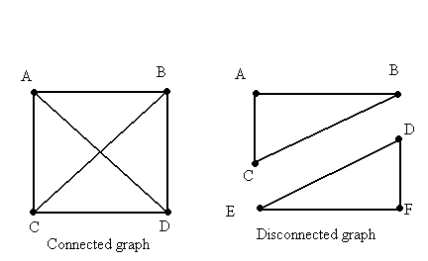
Connectivity
A series of edges is called a “path.”
If there exists a path between two nodes, the two nodes are “connected.”
If every pair of nodes in a graph is connected, the entire graph is “connected”, otherwise it is “disconnected”.
A disconnected graph can be divided into multiple connected components
Connected graph has only 1 connected component

Slide 34
How to find the shortest path between two nodes?

Slide 35
How to find the shortest path between two nodes?

Slide 36
How to find the shortest path between two nodes?

Slide 37
How to find the shortest path between two nodes?

Slide 38
How to find the shortest path between two nodes?

Slide 39
How to find the shortest path between two nodes?

Slide 40
How to find the shortest path between two nodes?

Slide 41
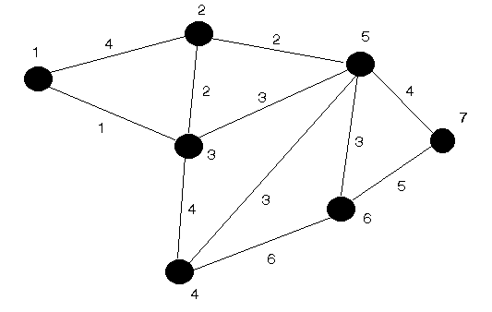
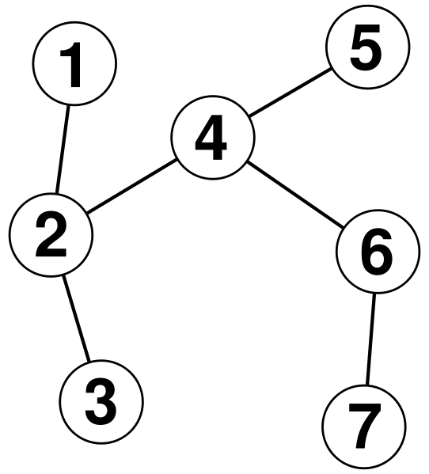
Cycles
A series of edges (a path) starting and ending in the same node is called a “cycle.”
Q: Which graphs have cycles:

Slide 42
How to find a cycle in a graph?

Slide 43
How to find a cycle in a graph?

Slide 44
How to find a cycle in a graph?

Slide 45
How to find a cycle in a graph?

Slide 46
How to find a cycle in a graph?

Slide 47
How to find a cycle in a graph?

Slide 48
How to find a cycle in a graph?

Slide 49
How to find a cycle in a graph?

Slide 50
How to find a cycle in a graph?

Slide 51
How to find a cycle in a graph?

Slide 52
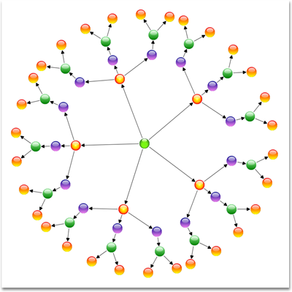
Trees
A connected graph with no cycles is called a “tree”.
If we remove “connected” from this definition, the graph will be called a “forest”.
Exercise: If we have a tree with n nodes, how many edges will it have?
(hint: draw some small examples of trees and see what you get.)

Slide 53
Idea
Leaves in a tree: a node with degree 1 is called a leaf of the tree
Every tree has at least two leaves

Slide 54
Idea
Leaves in a tree: a node with degree 1 is called a leaf of the tree
Every tree has at least two leaves

Slide 55
Idea
Leaves in a tree: a node with degree 1 is called a leaf of the tree
Every tree has at least two leaves

Slide 56
Idea
Leaves in a tree: a node with degree 1 is called a leaf of the tree
Every tree has at least two leaves
Remove leaves and its connected edges will not change the difference between the number of nodes and the number of edges

Slide 57
Idea
Leaves in a tree: a node with degree 1 is called a leaf of the tree
Every tree has at least two leaves
Remove leaves and its connected edges will not change the difference between the number of nodes and the number of edges

Slide 58
Idea
Leaves in a tree: a node with degree 1 is called a leaf of the tree
Every tree has at least two leaves
Remove leaves and its connected edges will not change the difference between the number of nodes and the number of edges
Kept removing leaves from the tree, we finally obtain a graph of a single node
#nodes-#edges=1 in a tree

Slide 59
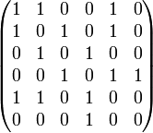
Adjacency Matrix
When we can’t draw a graph, we can represent it with a matrix.
If row i, column j contains a 1, there is an edge between nodes i and j. If there’s a 0, there’s no edge.
Exercise: Draw the graph for this adjacency matrix. What’s the degree of each node? Is there something special about node 1? Are there any cycles? What are their lengths?

Slide 60
Adjacency Matrix
2
1
3
4
6
5

Slide 61
Adjacency Matrix
2
1
3
4
6
5

Slide 62
Adjacency Matrix
2
1
3
4
6
5

Slide 63
Adjacency Matrix
2
1
3
4
6
5

Slide 64
Adjacency Matrix
2
1
3
4
6
5

Slide 65
Further topics:
Social Network:
Social Network Visualization
http://www.science.smith.edu/dftwiki/index.php/Visualizations:_Social_Networks
Classical Graph Theoretical Problems:
Seven Bridges of Konigsberg
Traveling Salesman Problem
Four Color Theorem
Algorithms on graphs
What’s more?
Algebraic graph theory: Complexity theory
Extremal graph theory: Cryptography, Coding theory
Random graph theory: Social networks, Network navigation
Machine learning

Slide 66
Exercise 1: Easy graph theory
First, take a look at matrix.txt
It’s an adjacency matrix
Now, look at graphs.py
All we’ll do is implement two simple functions:
matrix_load() reads the matrix.txt file and loads it into a matrix (an array of arrays)
print_degrees() prints the degrees of each node
Comments / hints are provided above each function.
Optional: is_connected() returns 1 if the graph is connected, 0 otherwise.

Slide 67
Mini-Project: Shortest Path
Next we’ll do something harder.
Implement a function that finds the shortest path between arbitrarily two nodes:
def shortest_path (mat,node1,node2)
Print out ‘No such path’ and return [] if node1 and node2 are not connected
Print out the shortest path by the edges on the path and return a list containing the nodes on the graph otherwise.
It’s not obvious how to do this at first – try out some ideas on paper, then code it up only when you have a working algorithm that you can do manually.
Generate multiple random graphs to test on your program

Slide 68
Mini-Project: Cycle Detection
Next we’ll do something harder.
Implement a function that detects whether or not there is a cycle in the graph. The definition will be:
def detect_cycle(mat)
Print out an arbitrary edge on the cycle and return a list containing all nodes on the cycle if there is one
Print out ‘No cycle in the graph’ and return [] otherwise
In the first step, assume the graph is connected and solve the problem.
Generate multiple graphs to test on your program
Question: Does it make any difference if the graph is directed?

Slide 69
Mini-Project: Cycle Detection for General Graphs
Next we’ll do something harder.
Bonus: solve it for more general graphs that contain multiple connected components
The definition will be:
def detect_cycle_gen(mat)
The requirements are specified in CycleGen_E.py
Generate multiple graphs to test on your program
Question: Does it make any difference if the graph is directed?

Slide 70
Mini-Project: Preliminaries
Things you might need in Python:
Lists
Suppose A is a list
A.append(x) appends x to A
The expression (x in A) returns True if A contains x, otherwise it returns False
A[n] returns the (n+1)-th element of A
The elements of a list could also be lists
A=[2,3,[4,5],6,[7,[8,9]]
A[0]=2,A[1]=3,A[2]=[4,5],A[3]=6,A[4]=[7,[8,9]]
A[2][0]=4,A[2][1]=5
A[4][0]=7,A[4][1]=[8,9]
A[4][1][0]=8,A[4][1][1]=9
Reading files
Filename “matrix.txt”
Fh=open(“matrix.txt”)
A=Fh.readlines() will return a list containing all the lines of the file

Slide 71
Mini-Project: Preliminaries
Things you might need in Python:
Reading files
Filename “B.txt”
Fh=open(“B.txt”)
A=Fh.readlines() will return a list containing all the lines of the file
Example
If the file “B.txt” contains the following text:
Hello world!
010001
Python
Then A=[‘Hello world!’, ‘010001’, ‘Python’]
Each component of A is a string

Slide 72
References
Graphs: http://people.brunel.ac.uk/~mastjjb/jeb/or/graph.html
Graph Theory: http://en.wikipedia.org/wiki/Graph_theory
Kevin Bacon: http://oracleofbacon.org/

